Slide 1

Online Retail Analysis
Analyzing Sales Data to Drive Business Insights
Project By: Priyanka Sahu
PGA 38

Slide 2
Objective
The objective of this project is to analyze an Online Retail dataset using SQL for data extraction and Power BI for visualization. The project aims to uncover key insights related to sales performance, customer behavior, and geographical demand. By leveraging SQL queries, the data is cleaned, aggregated, and prepared for analysis. Power BI is then used to create dynamic visuals that help in identifying trends, top-performing products, and potential markets for expansion. The final goal is to provide actionable insights that can guide strategic business decisions.

Slide 3
About the Dataset
Invoice No: A unique identifier for each transaction. Each invoice number corresponds to a specific order placed by a customer.
Stock Code: A unique code assigned to each product. This code is used for inventory management and product identification.
Description: A brief description of the product purchased. It provides insight into the types of products being sold and their characteristics.
Quantity: The number of units of each product purchased in a specific transaction. This column helps in analyzing sales volume and product demand.
Invoice Date: The date and time when the transaction occurred.
. This column is crucial for time-series analysis, trend identification, and understanding purchasing behavior over time.
Unit Price: The price per unit of the product at the time of the transaction. This column allows for revenue calculations and price analysis.
Customer ID: A unique identifier assigned to each customer. This column is used to track customer behavior, segment customers, and analyze repeat purchases.
Country: The country where the customer is located. This information is used for geographic analysis and helps in understanding the distribution of sales across different regions.

Slide 4
Procedure
Step I: Importing the Dataset
Open Power BI:
Launch Power BI Desktop.
Load Data:
Go to the Home tab and click on Get Data.
Select the data source Excel that contains your dataset.
Locate and select your dataset file, then click Load.
Step II :
Review all the Columns : InvoiceNo. , StockCode , Description , Quantity , InvoiceDate , UnitePrice , CustomerID , Country.
Ensure that the data types are correct :
InvoiceDate should be DateTime type .
Quantity and UnitPrice should be Number types.
Customer ID is in both number and text (can be a Text or Number type depending on your needs).
Check for any missing values. If there are nulls, decide whether to fill them, drop them, or replace them with default values.

Slide 5
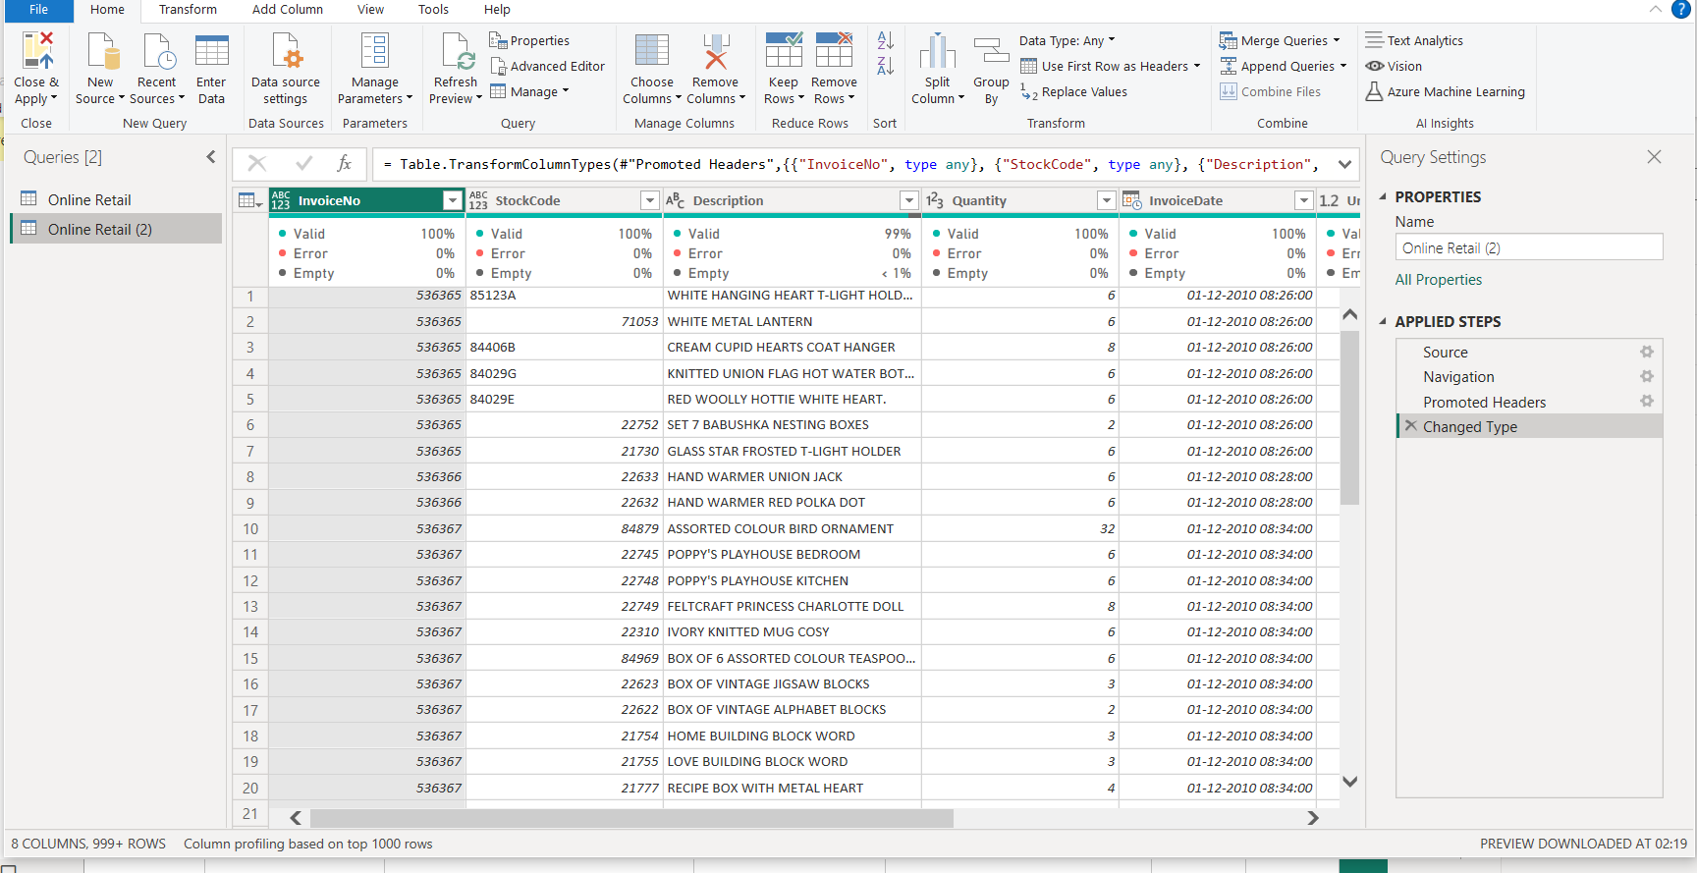

Slide 6
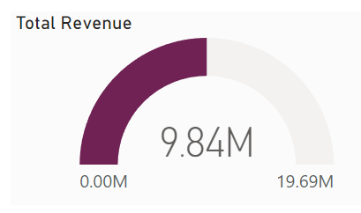
Visual Creation Process and Key Insights
Step III: Creating Visuals
1.Donut Chart: Total Revenue
- Insert a Donut Chart.
- Add the Revenue field to Values
Optionally, add Country or CustomerID to legend for breakdown.
Offers a clear visual representation of total revenue is 9.84M, allowing quick assessment of overall sales performance.
2. Dropdown Filters: Country, Month, Customer ID
- Add Slicer for Country, InvoiceDate(format to Month), and CustomerID
- These filters will refine the visuals.
Allows dynamic filtering of data, enabling users to drill down into specific regions, periods, or customer segments. This feature helps in identifying trends and outliers within specific contexts.

Slide 7
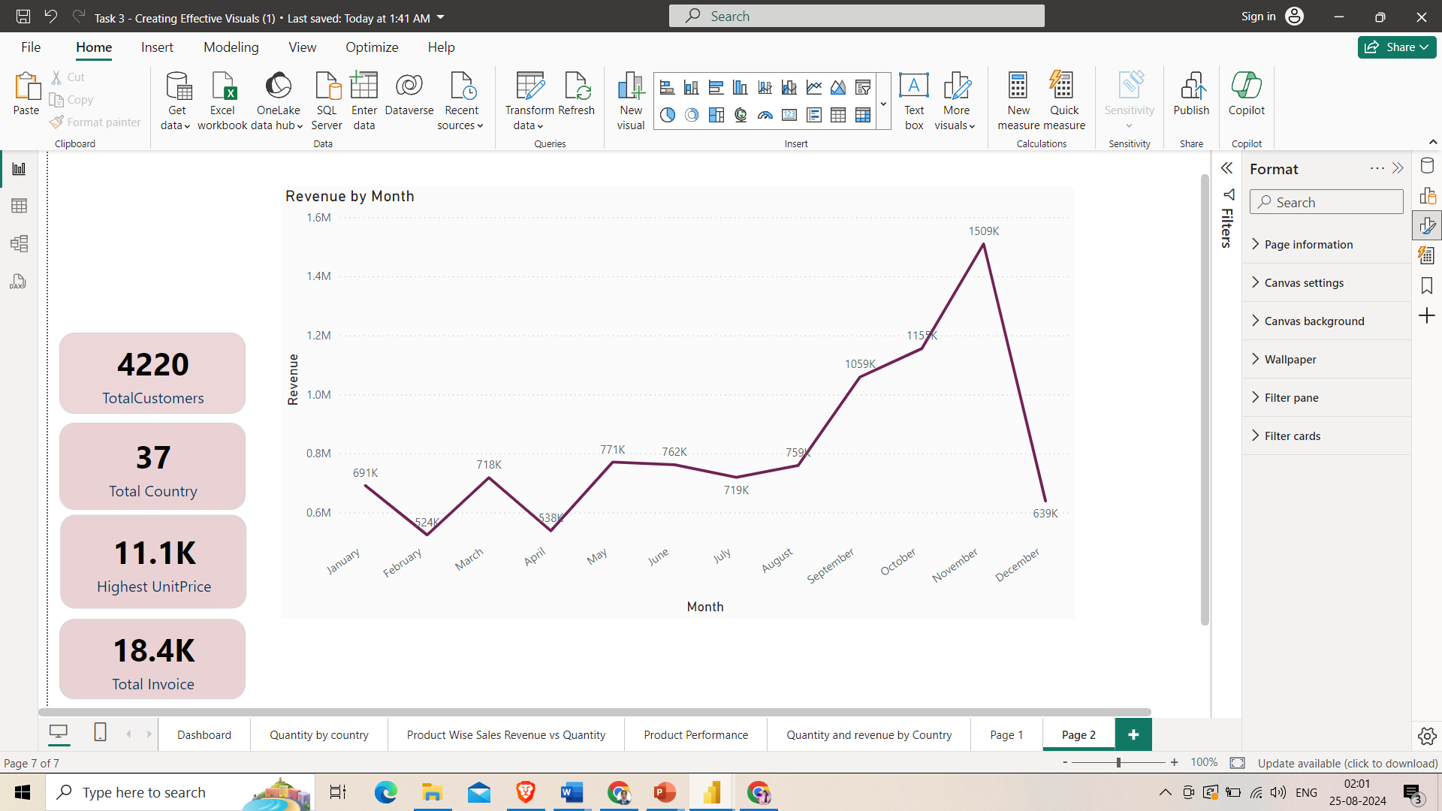
Visual Creation Process and Key Insights
Step III: Creating Visuals
3. Line Chart: Revenue by Month
Insert a Line Chart.
Add InvoiceDate to Axis (set to Month).
Add Revenue to Values.
According to the data, there are several months of the year that have significant development. According to the statistics, the first eight months of sales from January to August were very stable, with an average of 759K in revenue per month. The increase in revenue begins in September, when it grows by 40% over the previous month. This pattern persisted up until November, when it rose to 1509K (thousand), the largest amount of the whole year. Unfortunately, since the data for December is insufficient, no inferences can be made from it

Slide 8
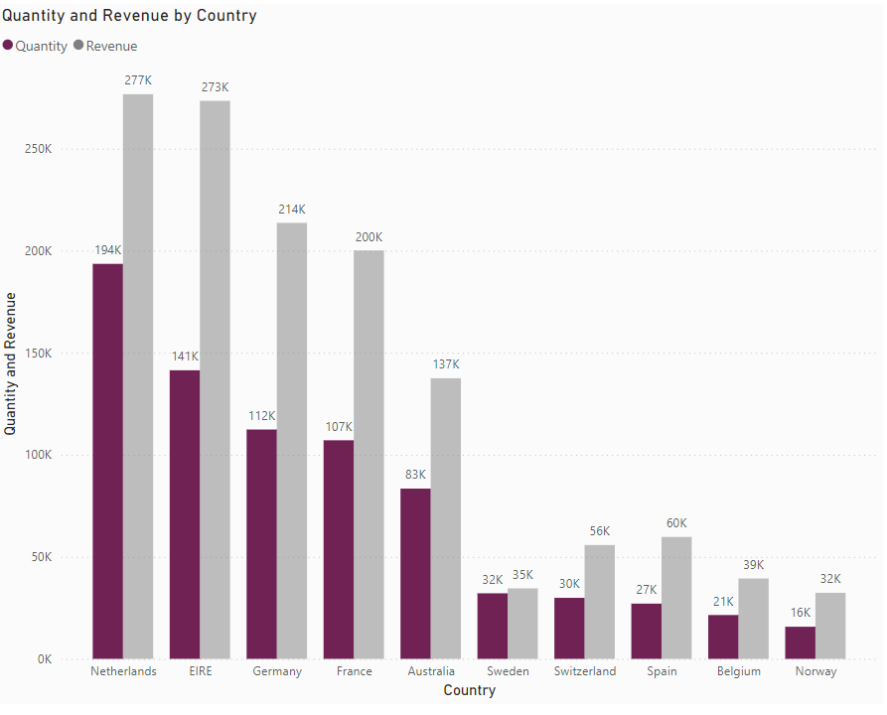
Visual Creation Process and Key Insights
4. Bar Chart: Quantity and Revenue by Country
- Insert a Clustered Bar Chart.
- Add Country to Axis
- Add Revenue and Quantity to Values
- Consider dual-axis for separate value display.
The top 10 countries with the most potential for growth are represented in the second graph. Since the UK already has a large demand and I understand you are more interested in nations where demand may be boosted, the UK is not included in these statistics. According to the data, sales of units and income are quite high in nations like the Netherlands, Ireland, Germany, and France. To guarantee that steps are taken to further seize these markets, I would propose concentrating on these nations.

Slide 9
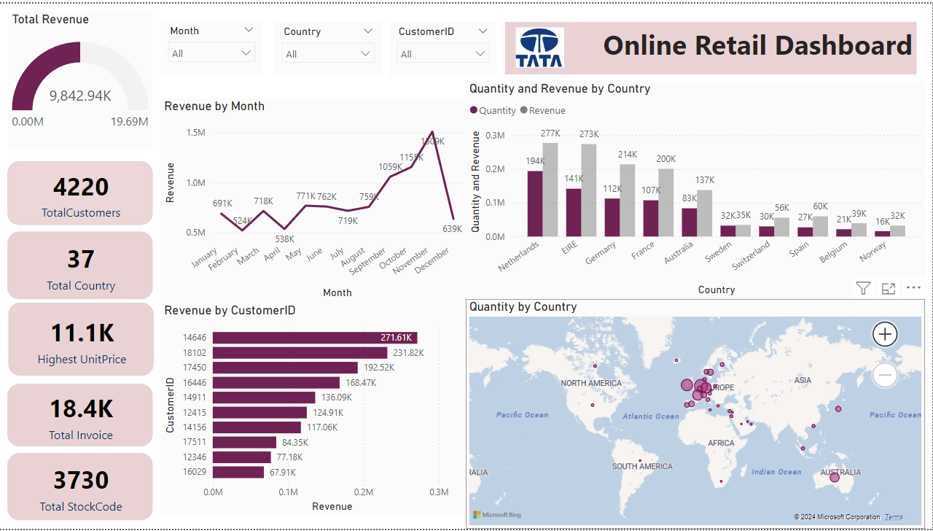
Visual Creation Process and Key Insights
5. Bar Chart: Revenue by Customer ID
- Insert a Clustered Bar Chart.
- Add CustomerID to Axis
Add Revenue to Values
The top 10 consumers who have made the most purchases from the business have been the subject of the third study. According to the statistics, there are not many differences between the top 10 consumer purchases. The fact that the highest revenue-producing consumer only spent 17% more than the second highest demonstrates that the company does not rely solely on a small number of consumers to generate income. This demonstrates that consumers' ability to negotiate is limited and that the state of business is positive.

Slide 10
Visual Creation Process and Key Insights
6. Map: Quantity by Country
- Insert a Map.
- Add Country to Location
Add Quantity to Size.
The map chart concludes by comparing the places that have produced the greatest revenue to those that have not. Apart from the UK, it is clear that nations like the Netherlands, Ireland, Germany, France, and Australia generate large profits, and the company should invest more in these nations to boost product demand. The map also reveals that the majority of sales occur only in the European zone, with only a small number in the American region. Along with Russia, there is no market for the items in Africa or Asia. Sales revenues and profitability might increase with the implementation of a fresh strategy focused on these areas.

Slide 11
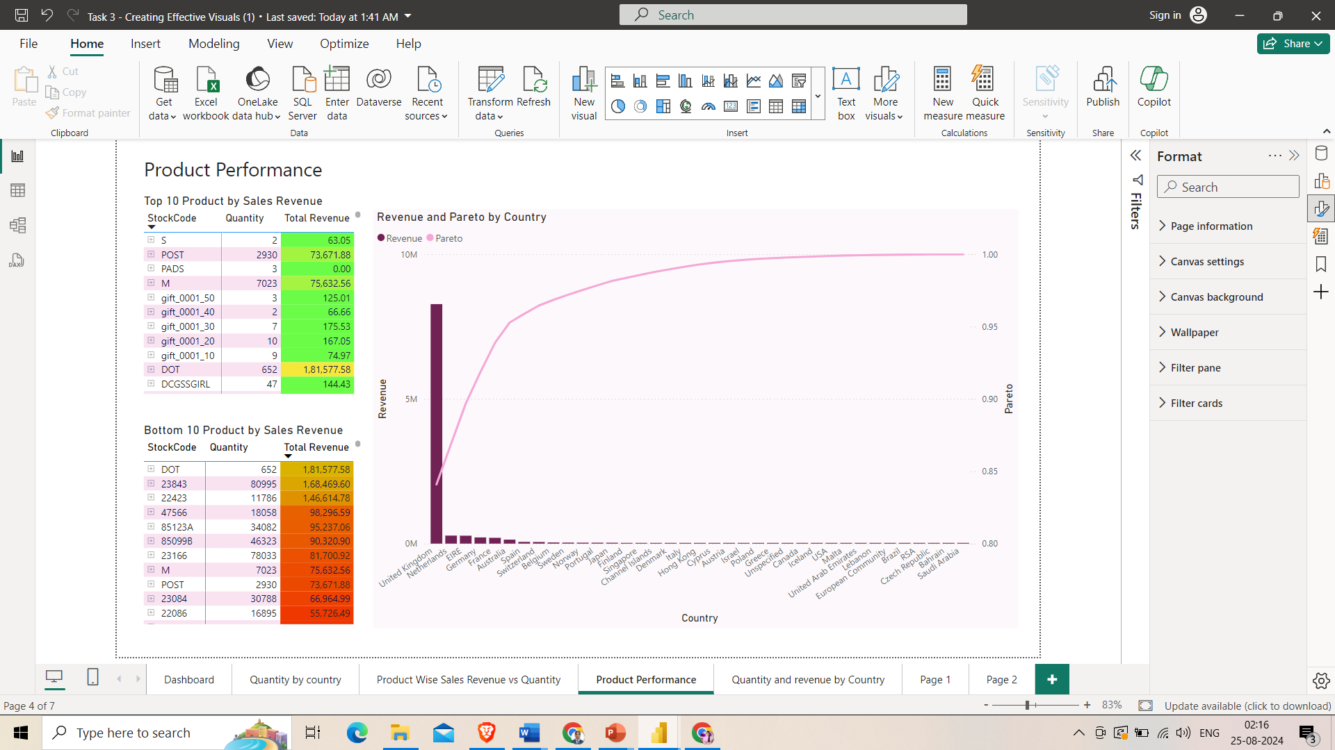
Visual Creation Process and Key Insights
7. Table: Top 10 Products by Sales Revenue
- Insert a Table.
- Add Description and Revenue to Values
- Sort by Revenue in descending order.
- Apply Top N filter for top 10 products.
8. Line and Bar Chart: Total Revenue & Revenue % by Country
- Insert a Line and Clustered Column Chart.
- Add Country to Shared Axis
- Add Revenue to Column Values.
Add Revenue Percentage to Line Values (calculated DAX measure).
9. Scatter Chart : Product Wise Sales Revenue vs Quantity .
Insert Scatter Chart.
Add Quantity to X-axis.
Add Total Revenue to Y-axis.
Set legend Stock Code.

Slide 13
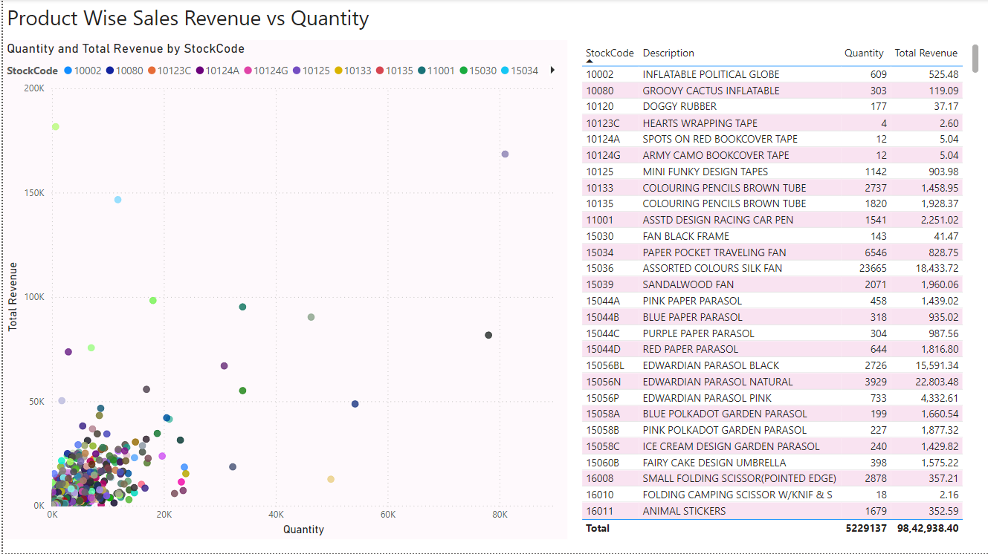

Slide 14
Overall Dashboard Insights
Strategic Decision-Making: The dashboard provides a comprehensive view of the business's performance, helping leadership to make data-driven decisions regarding marketing, sales strategies, and regional expansion
Market Opportunities: By analyzing revenue and quantity across countries, the company can identify underperforming regions that may benefit from targeted marketing efforts, or high-performing regions that could support expanded operations.
Customer Targeting: Insights into the top revenue-generating customers allow the business to focus on customer retention strategies, ensuring long-term loyalty and higher customer lifetime value.
Product Performance: The data on top-selling products can inform inventory management, pricing strategies, and promotional campaigns, ensuring that the most popular products are always available and competitively priced.

Slide 15
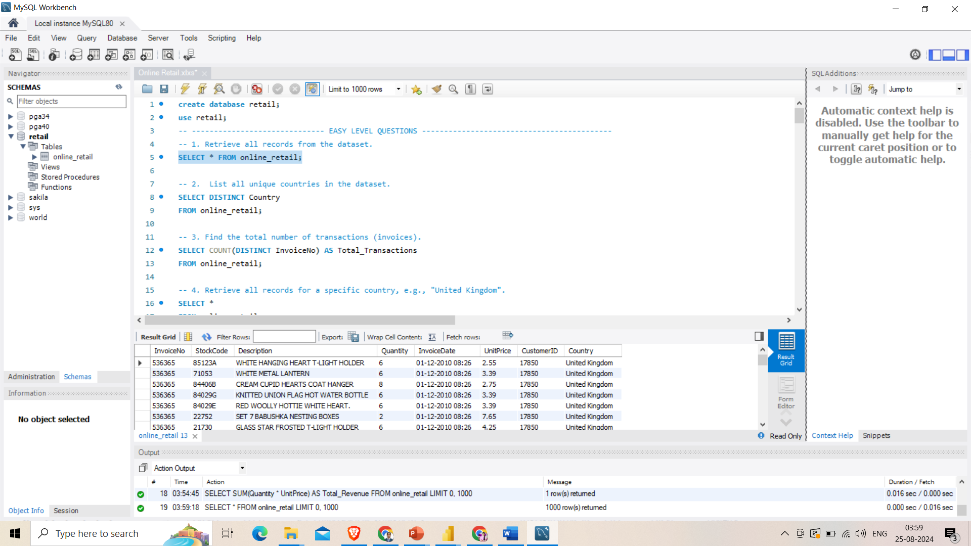
SQL ANALYSICS
Import the Online Retail dataset into the MySQL server. After importing, perform data cleansing and analysis to ensure the data is accurate and ready for further insights and decision making.

Slide 16
SQL Questions
List all unique countries in the dataset.
Find all records where the quantity is greater than 10.
List the top 5 countries by the number of transactions.
Retrieve the most frequently purchased item (StockCode).
Find the top 3 customers by total purchase amount.
Find all invoices where more than 10 unique items (StockCodes) were purchased.
Find the total number of items sold per country.
Retrieve the top 5 products with stockcode by revenue generated.
Find the average quantity of items purchased per transaction for each customer.
Determine the top 3 products that contributed to the highest revenue in 'United Kingdom’.
Identify the customers who purchased more than 100 items in a single transaction.
Find the average revenue per customer and compare it between two specific countries, e.g., 'Germany' and 'France'.

Slide 17
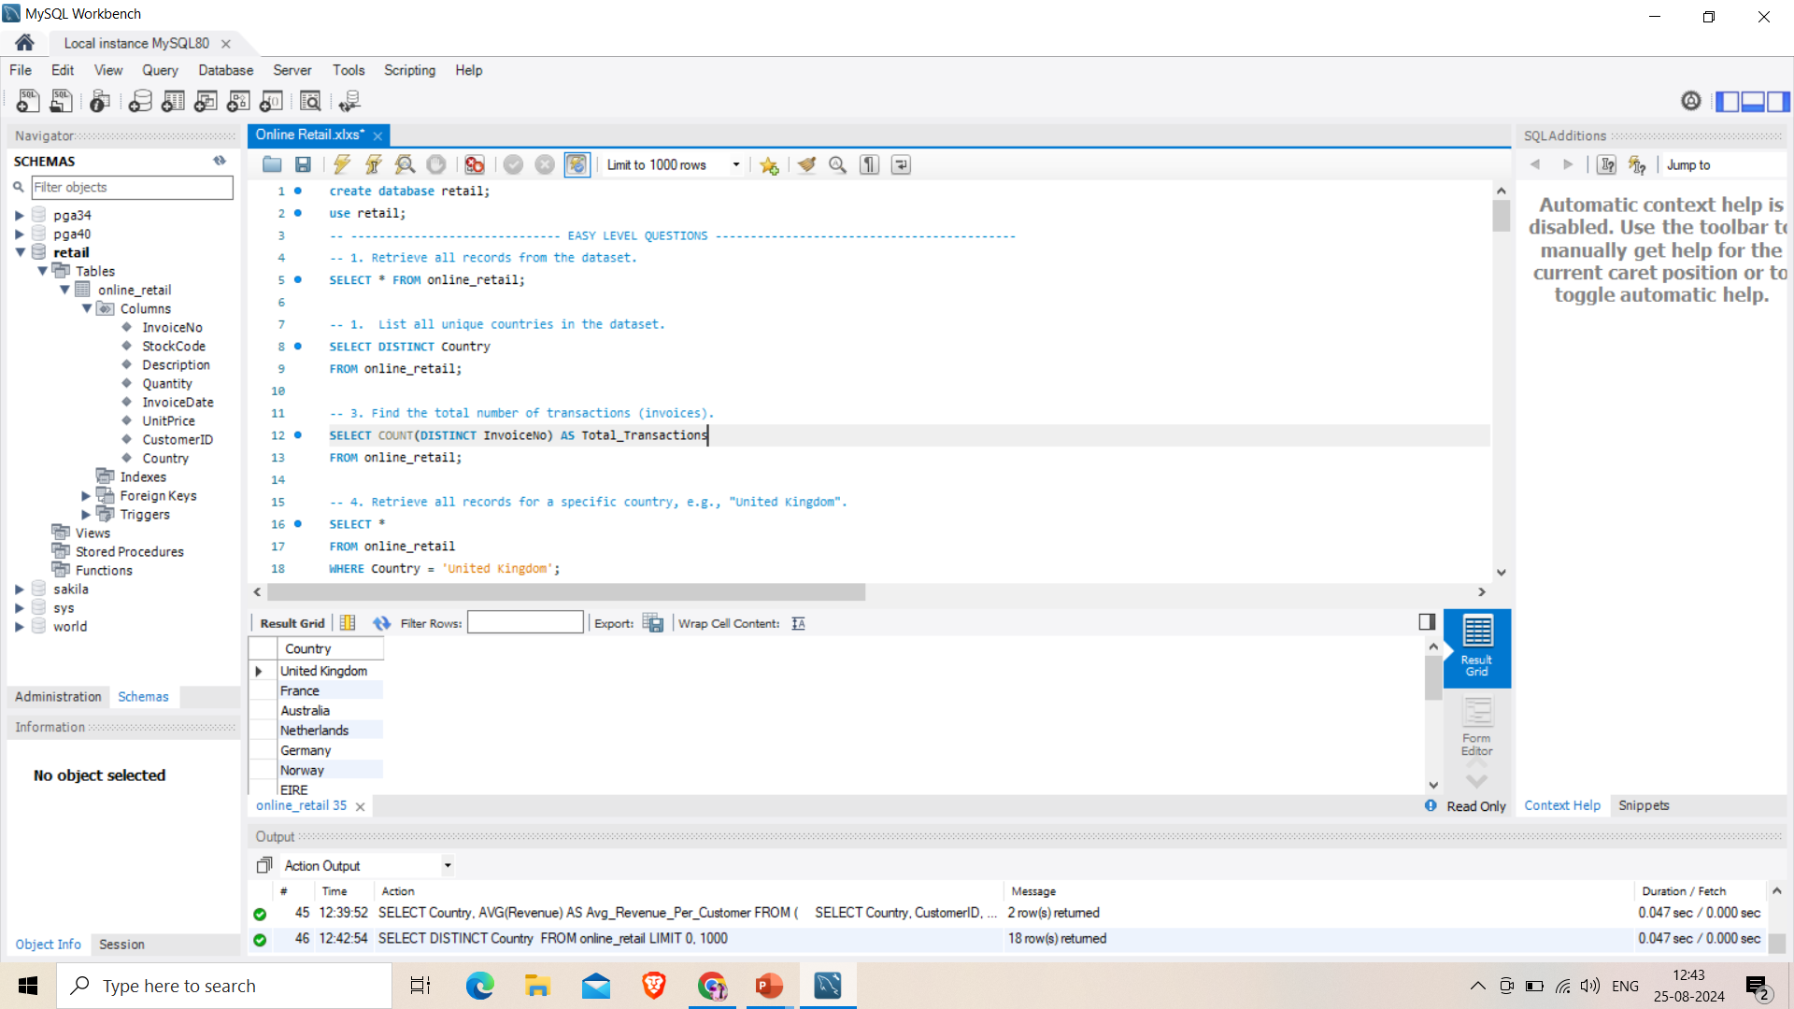
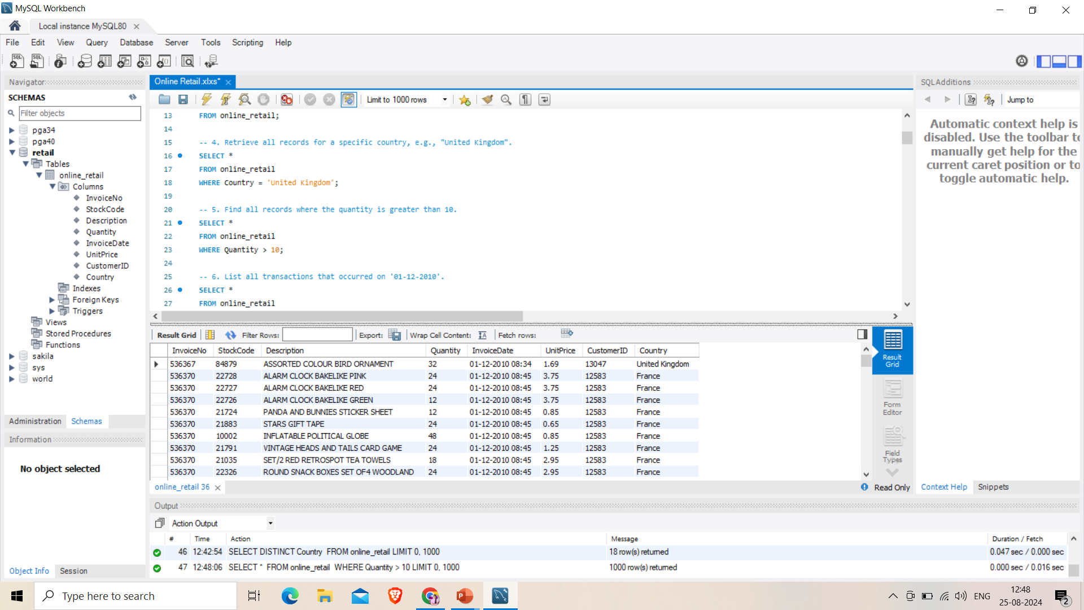

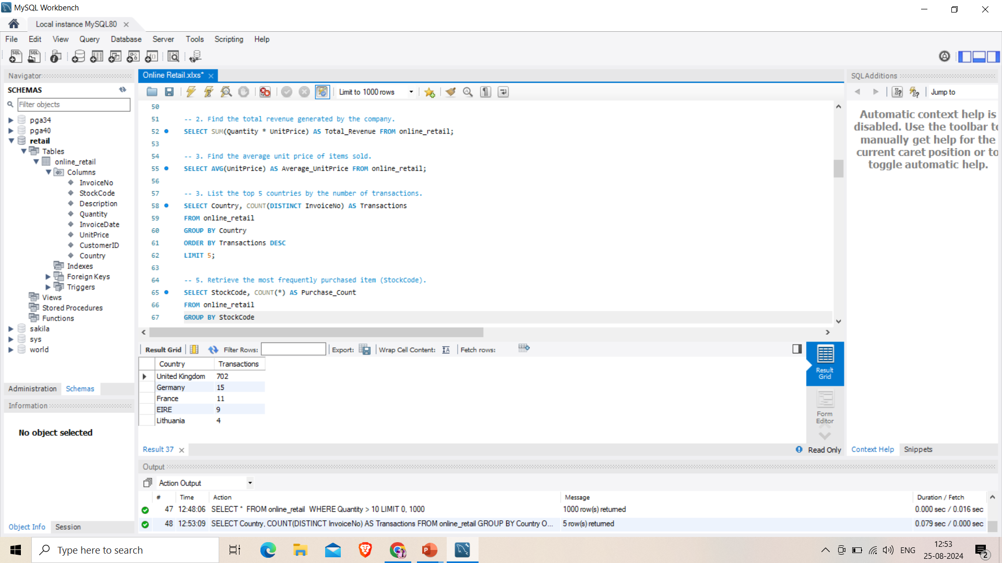

Slide 18
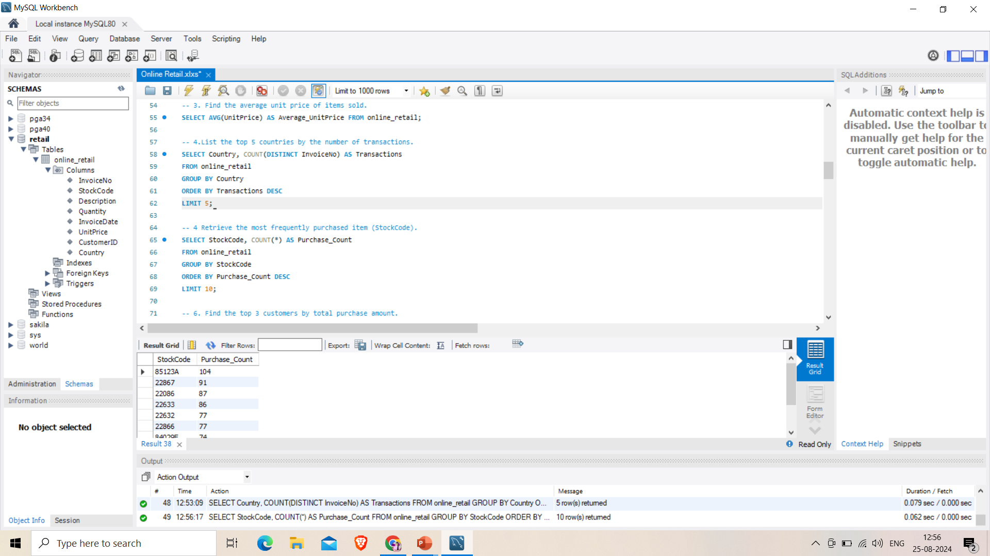
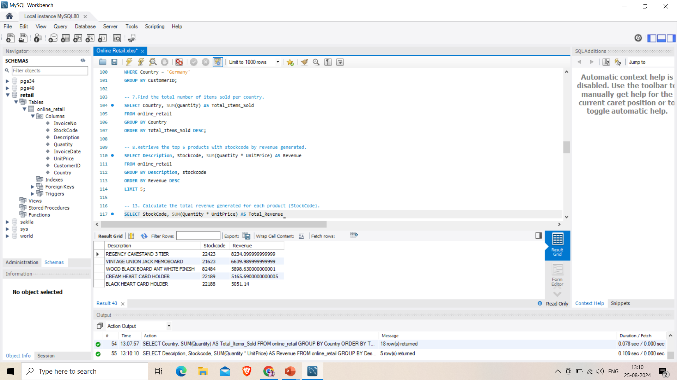
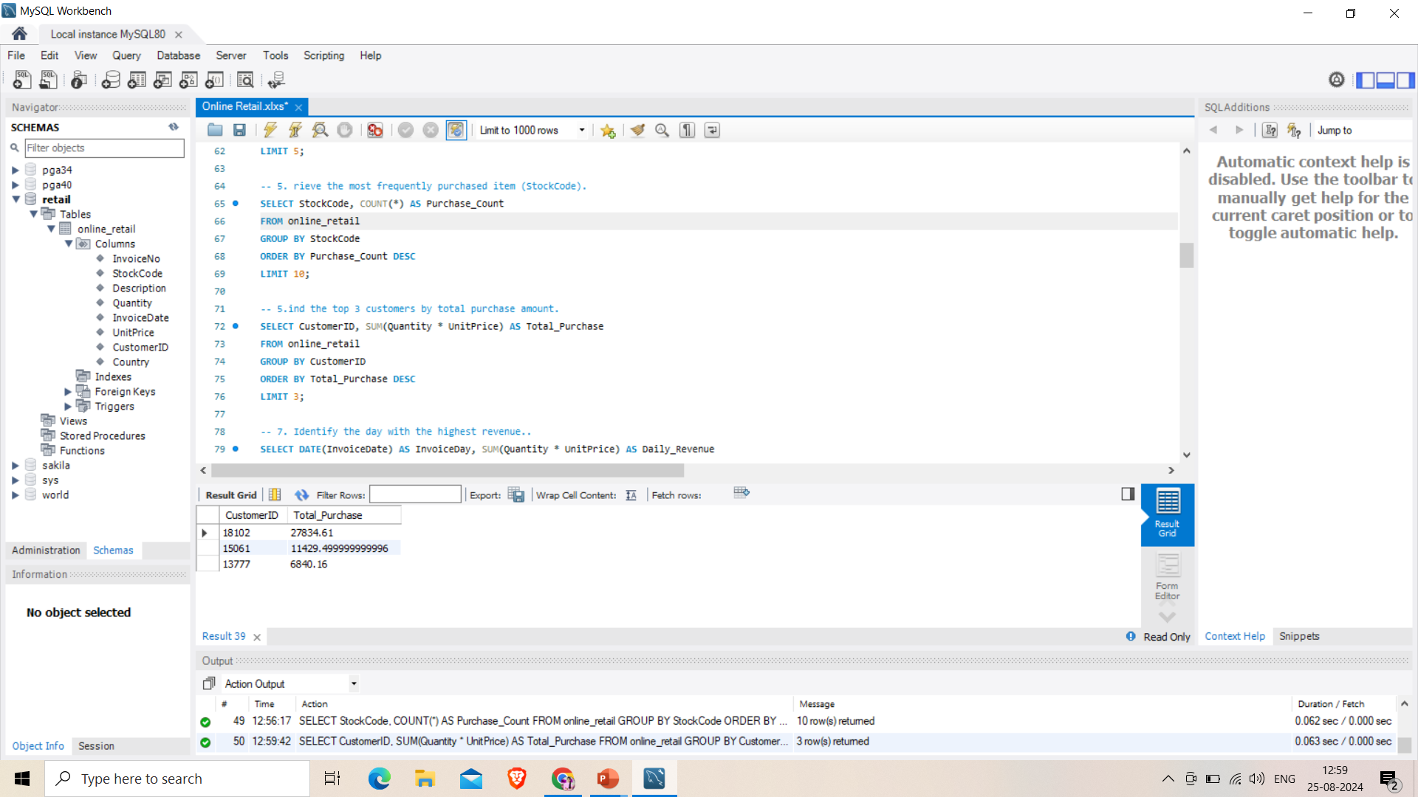
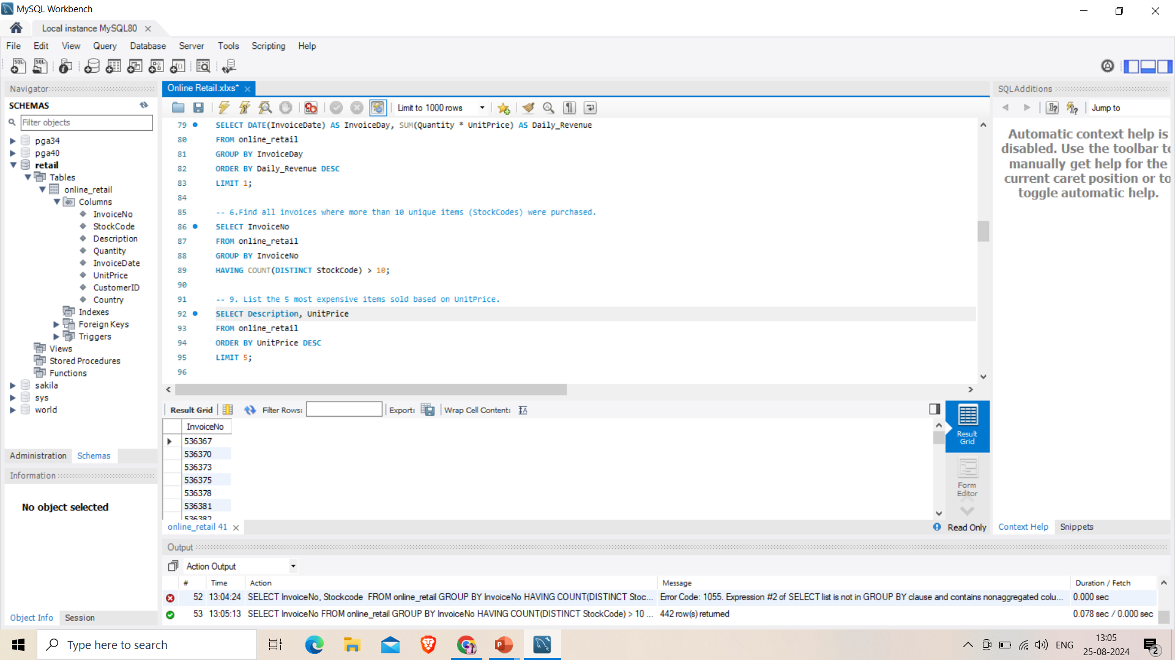
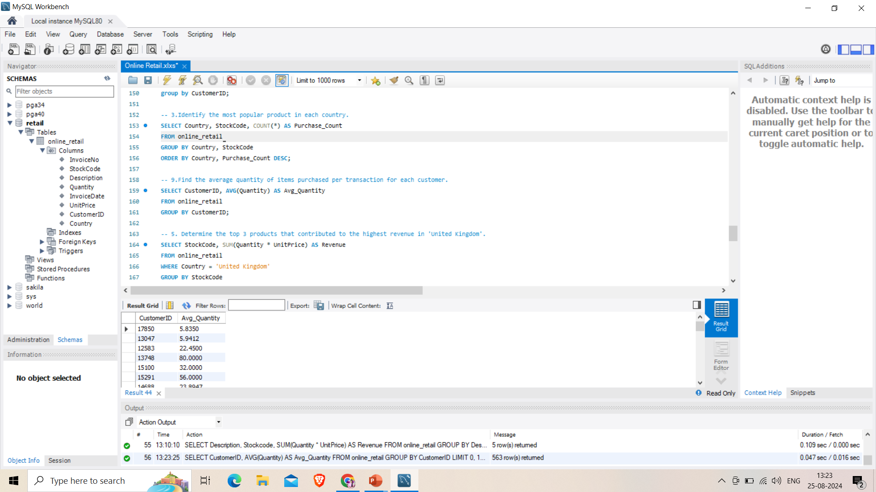
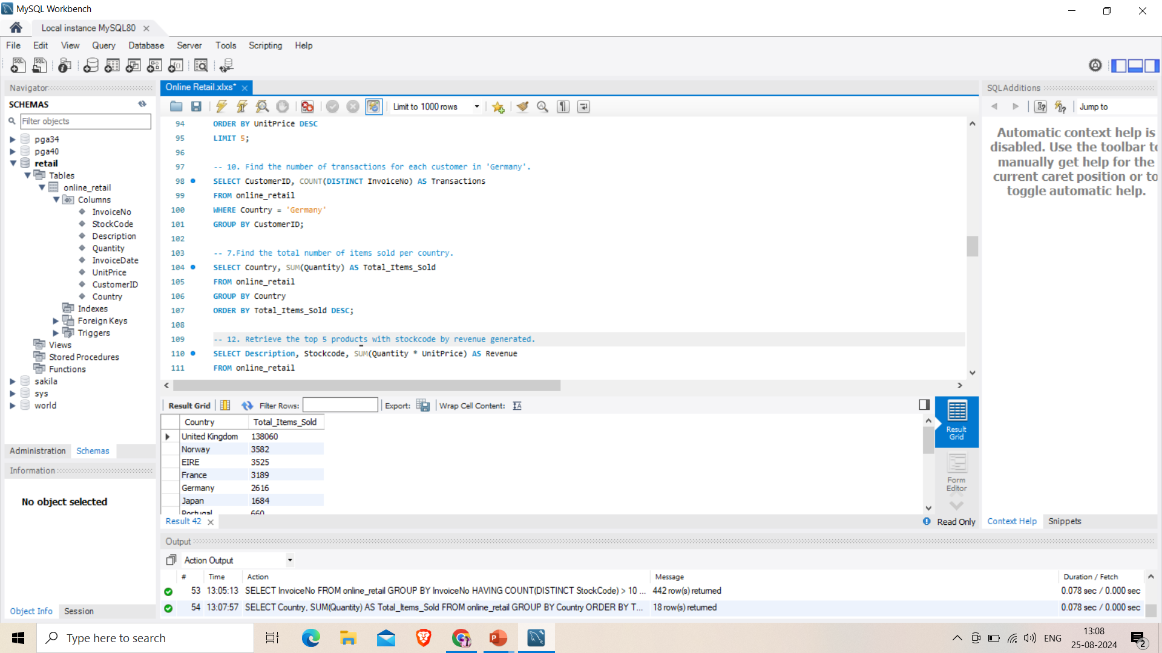

Slide 19
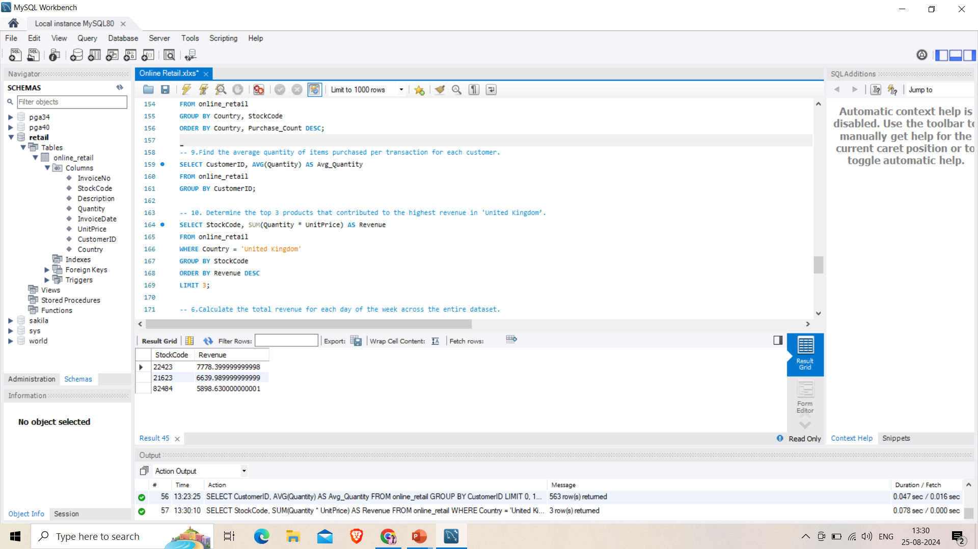
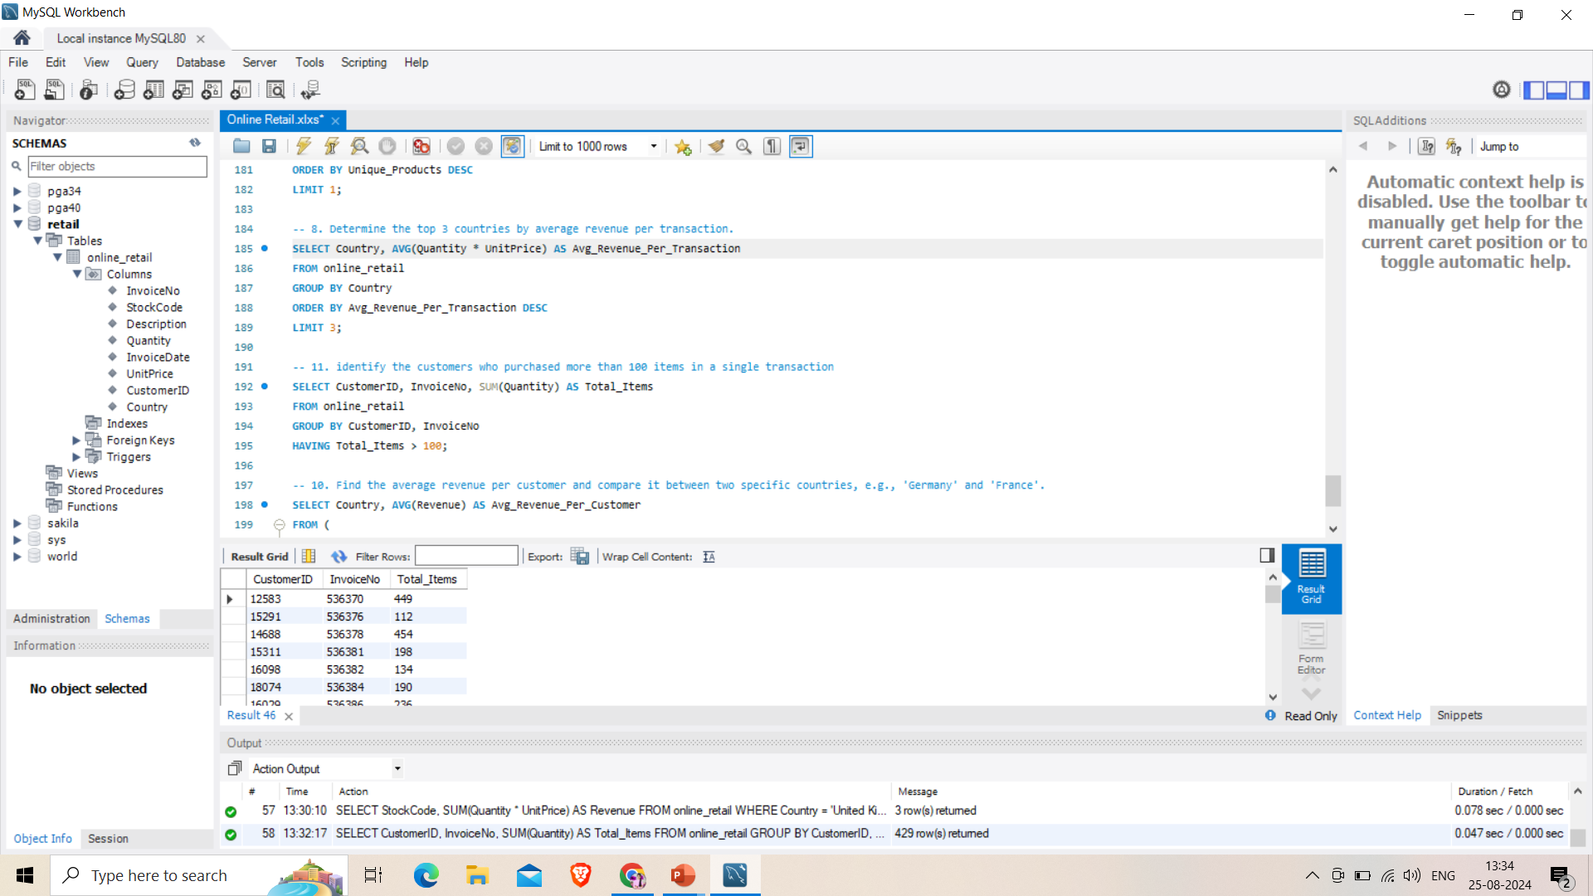
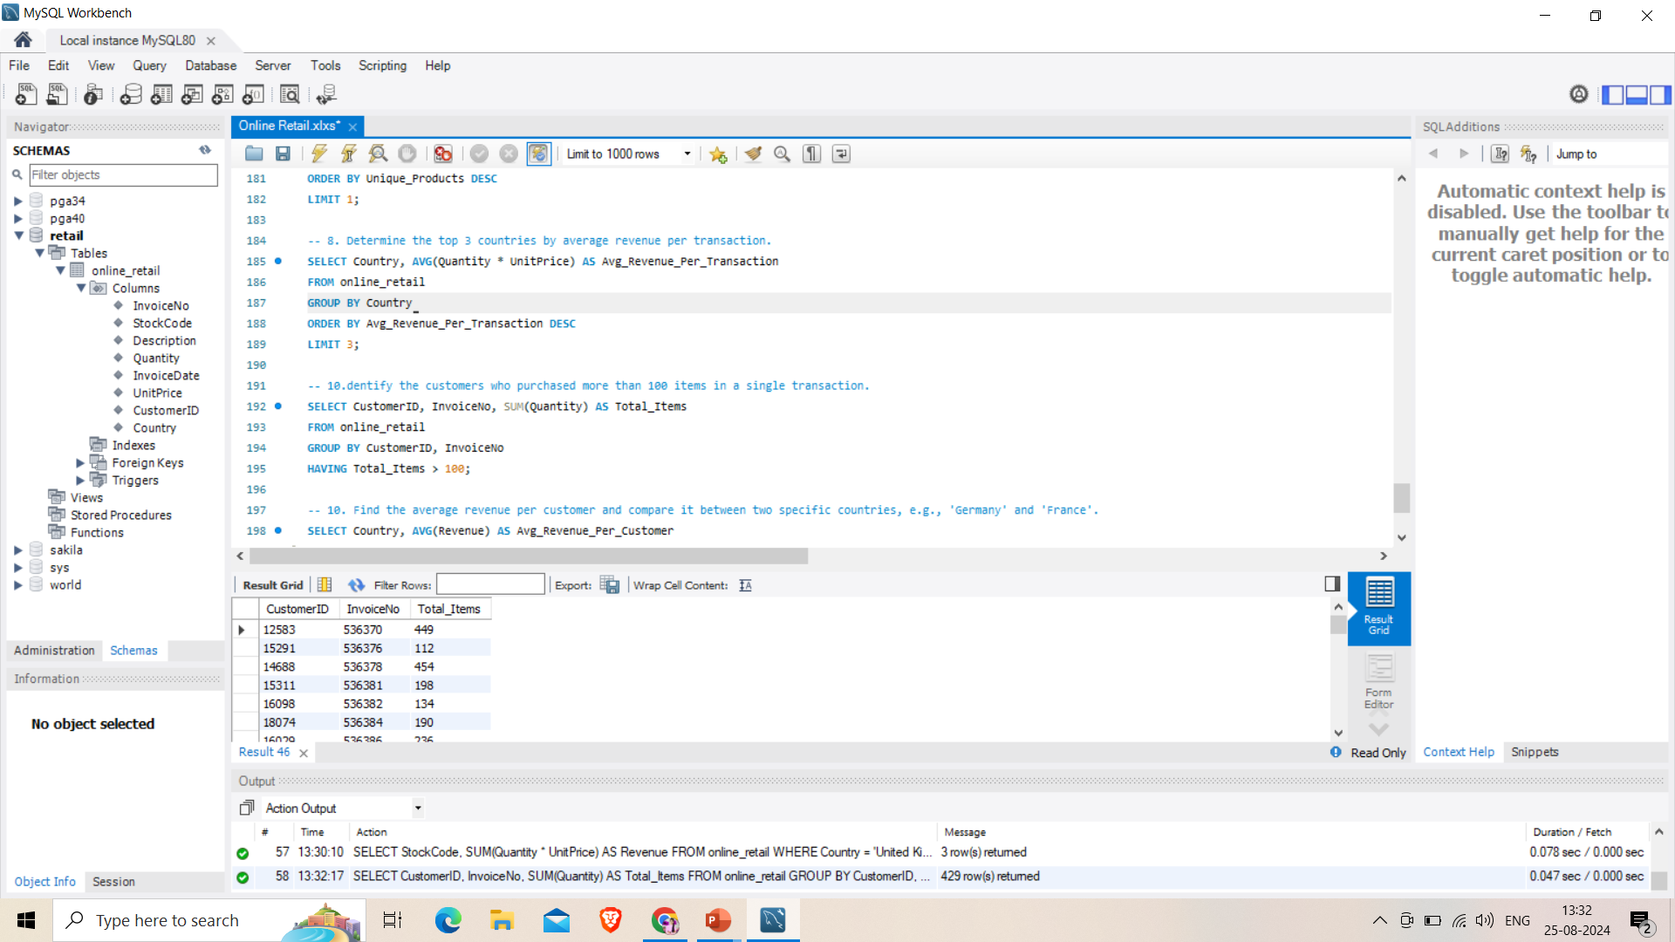
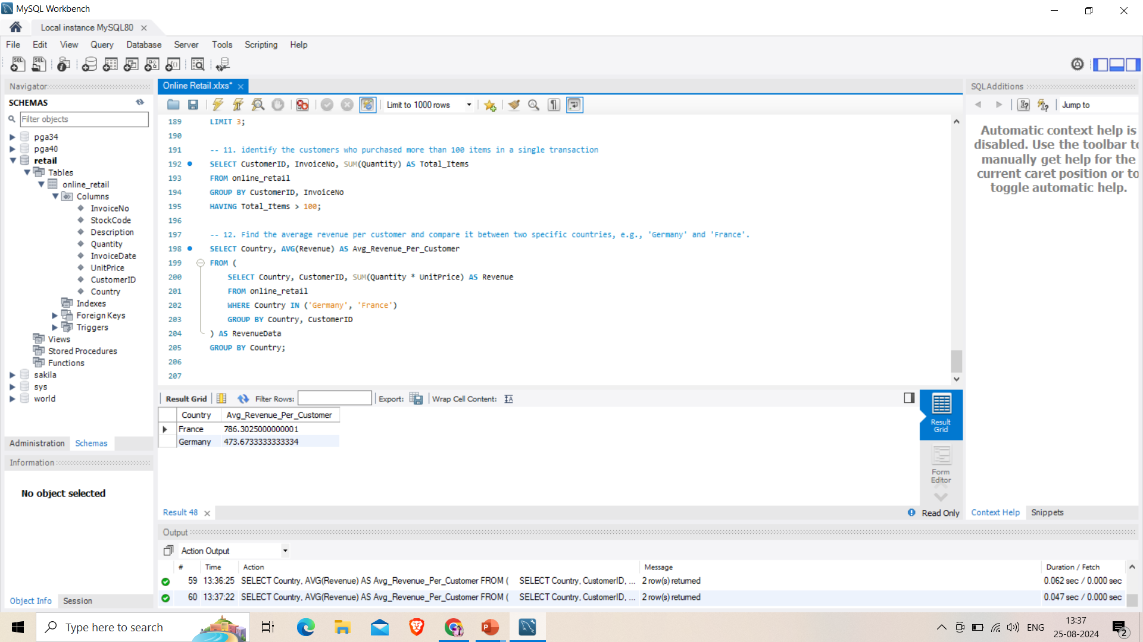

Slide 20
Conclusion
The project successfully demonstrated the process of importing, cleansing, and analyzing an Online Retail dataset using SQL and visualizing key insights through Power BI. The analysis provided valuable information on sales trends, customer behavior, and geographic demand, which can be leveraged for strategic decision-making. By utilizing SQL for data preparation and Power BI for dynamic visualizations, the project offers actionable insights that can guide business strategies, improve customer satisfaction, and identify potential areas for market expansion.

Slide 21
THANK YOU
Priyanka Sahu
priyankasahu6226@gmail.com
PGA 38

